Slide 1
Max Clique Approximation Solution Code
CS412

Slide 2
Bron Kerbosch Pseudo Code
The algorithm maintains three disjoint sets of nodes, R, P, X. Set R stands for the currently growing clique; set P stands for prospective nodes which are connected to all nodes in R and using which R can be expanded; set X contains nodes already processed i.e. nodes which were previously in P and hence all maximal cliques containing them have already been reported. An important invariant is that all nodes which are connected to every node of R are either in P or X. Purpose of X is to avoid reporting the same maximal clique multiple times, through the update P = P − {ui}. To avoid reporting cliques which are not maximal, the algorithm checks whether set X is empty, if X is non-empty, the nodes in X may be added to R, but this would yield previously found maximal cliques.
BronKerbosch1(R, P, X):
If P and X are both empty:
Report R as maximal clique
For each vertex v in P:
BronKerbosch1(R ⋃ {v}, P ⋂ N(v), X ⋂ N(v))
P := P / {v}
X := X ⋃ {v}
Wikipedia Source

Slide 3
Example Call
R:{}
P:{1,2,3,4,5}
X:{}
algorithm BronKerbosch1(R, P, X) is
if P and X are both empty then
report R as a maximal clique
for each vertex v in P do
BronKerbosch1(R ⋃ {v}, P ⋂ N(v), X ⋂ N(v))
P := P \ {v}
X := X ⋃ {v}
R:{1}
P:{2,3}
X:{}
R:{1,2}
P:{3}
X:{}
R:{1,3}
P:{}
X:{2}
1
3
4
R:{1,2,3}
P:{}
X:{}
2
5

Slide 4
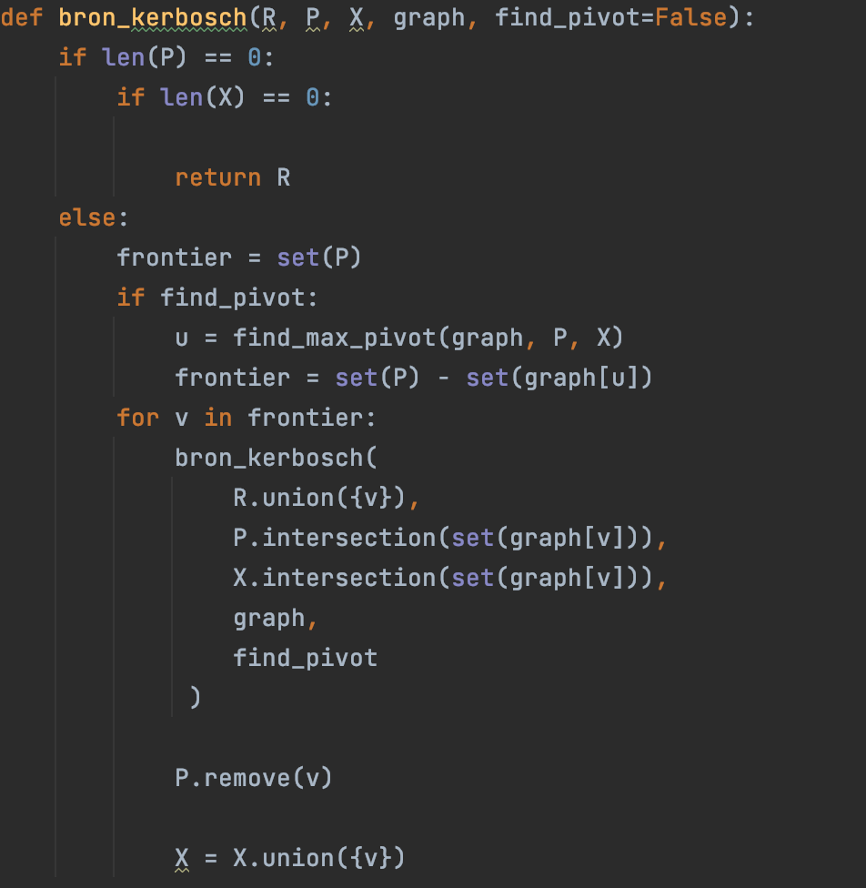
Python Code

Slide 5
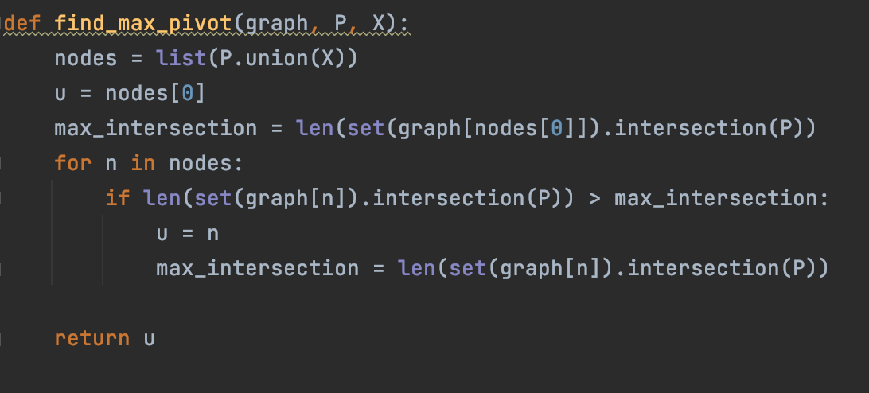
Python Code

Slide 6
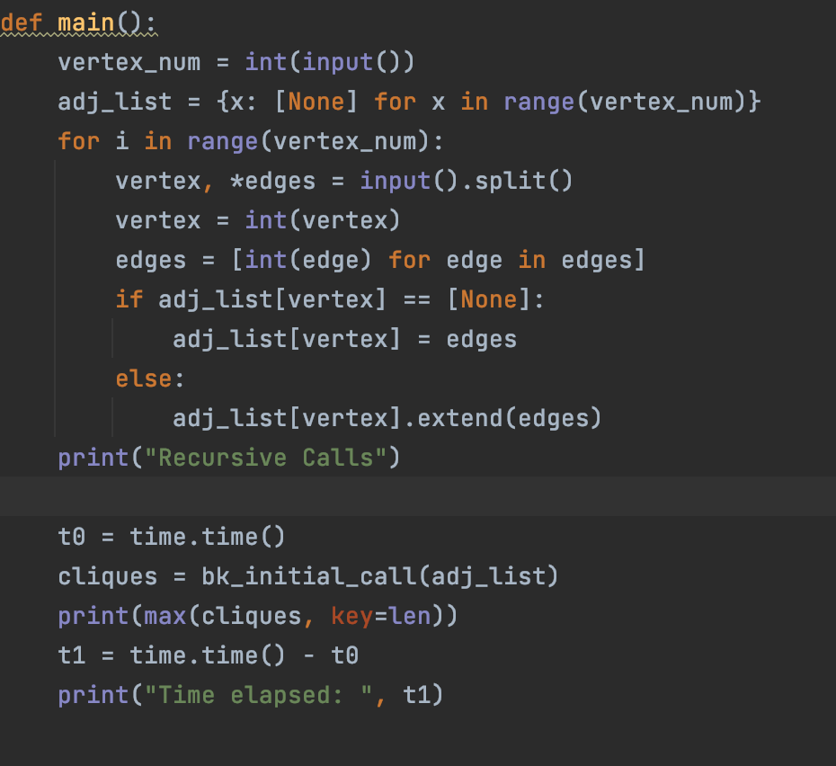
Python Code

Slide 7
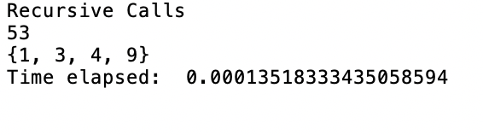

Sample

Slide 8
The basic form of the algorithm without pivoting is inefficient in the case of graphs with many non-maximal cliques, it makes a recursive call for every clique, maximal or not.
A pivot vertex of U is chosen from P which is the graph
Any maximal clique must include either u or one of its non-neighbors, for otherwise the clique could be augmented by adding u to it. Therefore, only u and its non-neighbors need to be tested as the choices for the vertex v that is added to R in each recursive call to the algorithm.

